Slide 1
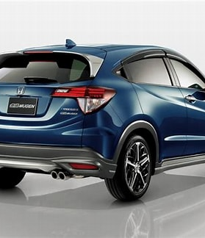
Subreddit Classifier Proof of Concept
Yiang Yuet Meng
Notes:
Line spacing + Page numbers

Slide 2
Agenda
01 Background
02 Data Gathering/Cleaning
03 EDA
04 Modelling
05 Conclusion
06 Further Improvements

Slide 3
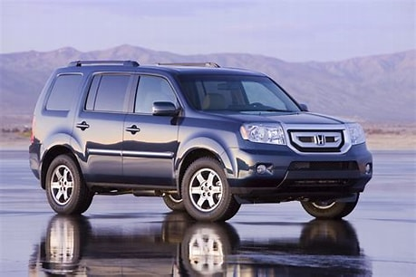


Background
01
Honda Customer Service main priority is to provide excellent service to our customers.
Recently, our customer service has been receiving a lot of irrelevant posts from Mazda. This is likely due to the year end promotion sales launched by Mazda. This has caused unnecessary stress to the team to keep up with the desired service level agreement.
Today my main objective is to develop a proof of concept using NLP and Machine Learning to analyze and segregate the posts and provide a solution to the customer service team.

Slide 4
Data Gathering and Cleaning
02

Slide 5
Data Gathering/Cleaning
Import from r/Honda and r/mazda.
Standard steps taken in data gathering and cleaning which includes removal of duplicate posts, deleted posts and lemmatizing of posts

Slide 6
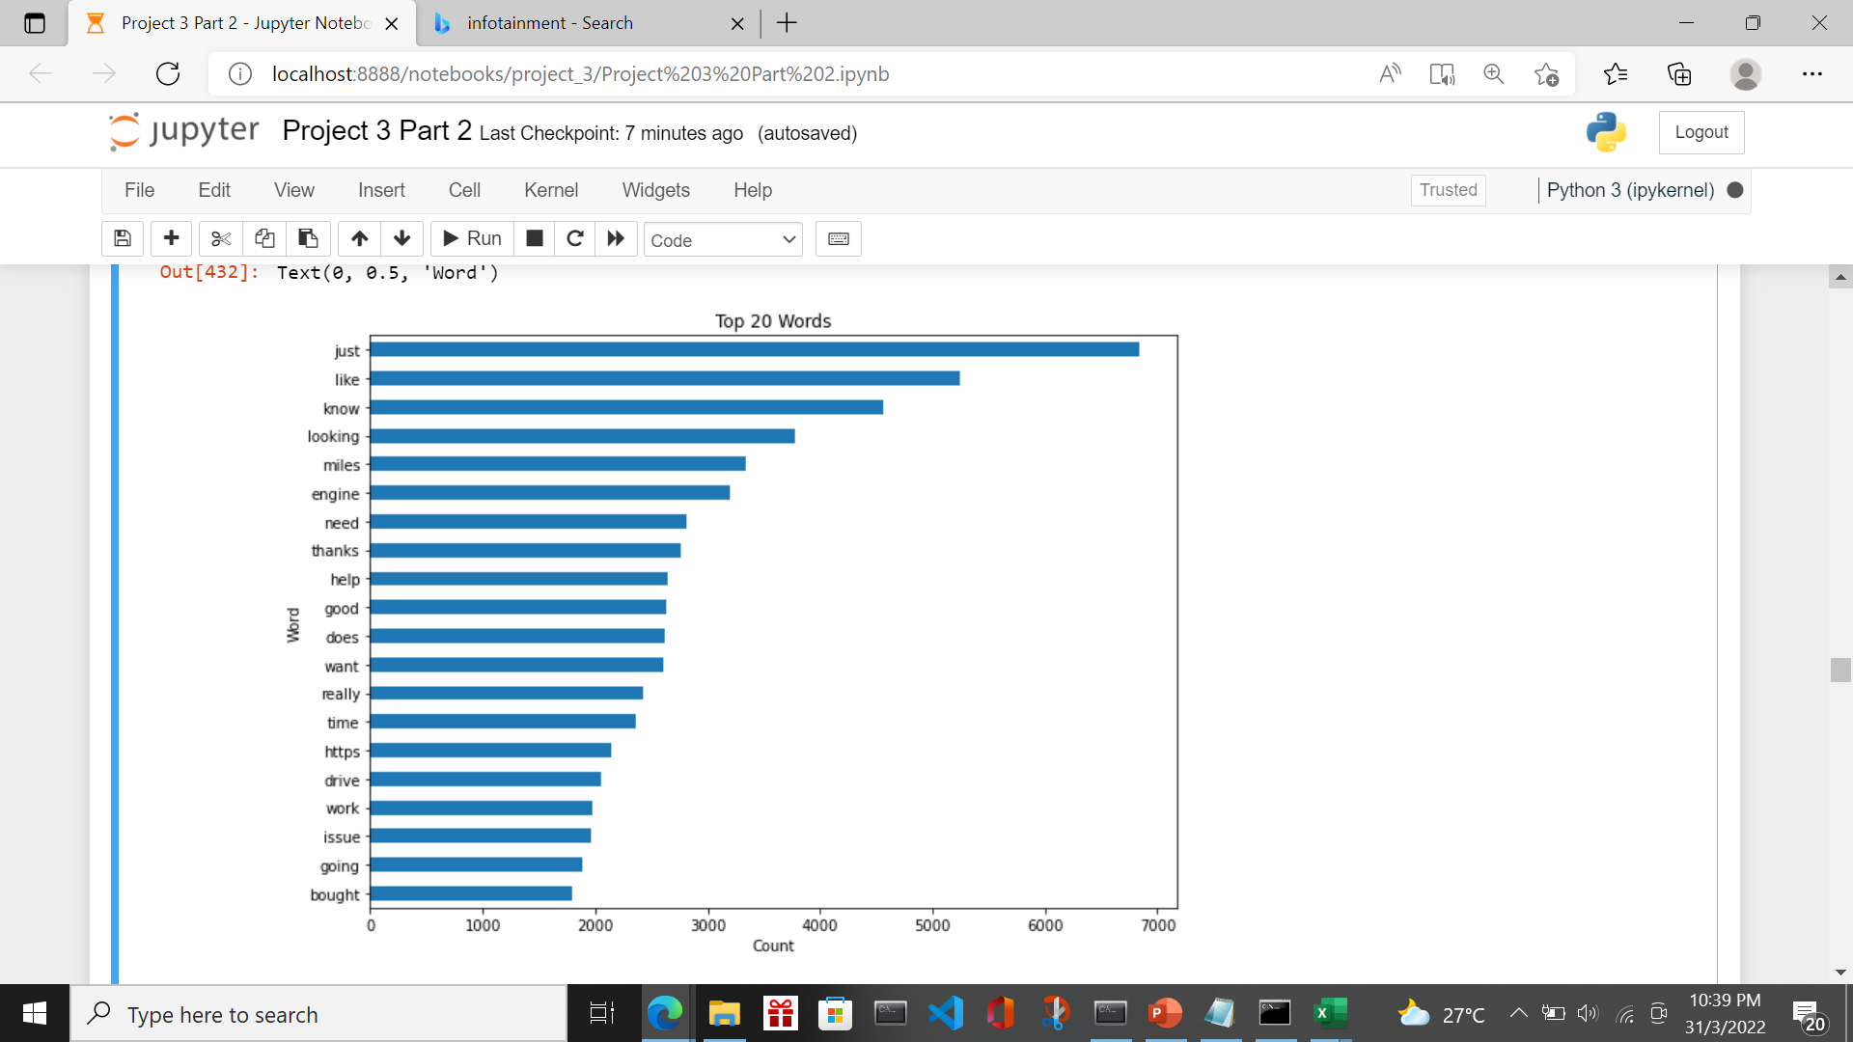
Data Exploratory Analysis
Key steps are reviewing and clearing of unnecessary punctuations, numbers etc as well as experimenting of different stop words to be introduced. Result below show that the text is cleared of model name, punctuation, special characters.

Slide 7
Modelling
03

Slide 8
Modelling Base Model
Multinomial Naive Bayes classifier is chosen
Train Score: 0.7804
Test Score: 0.7032
Accuracy: 0.7466
Misclassification: 0.2534
Precision: 0.668
Recall: 0.5567
Specificity: 0.8497
The model exhibits overfitting of train scores. I will use this model as the baseline model and explore other parameters and models

Slide 9
Modelling
Model |  | Parameters | Train Score | Test Sore | Metrics | Remarks
Model 1 | Random Forrest |  | 0.7656 | 0.6567 | Accuracy: 0.7447 Misclassification: 0.2553 Precision: 0.8092 Recall: 0.3593 Specificity: 0.954 | exhibits overfitting of train scores. I will explore to tune the parameters. Recall is low.
Model 2 | Multinomial Naive Bayes | cvec__min_df: 2, cvec__max_df=0.5, cvec__max_features: 5000, cvec__ngram_range: (1,1) | 0.7226 | 0.722 | Accuracy: 0.722 Misclassification: 0.278 Precision:0.6027 Recall: 0.6159 Specificity: 0.7796 | Tuning of CountVectorizer It is overall better than the baseline model. It is slightly more accurate. There is no sign of overfitting of training set in this case. Recall improves
Model 3 | Random Forrest | cvec__min_df: 3, cvec__max_df=0.75 cvec__max_features: 5000, cvec__ngram_range: (1,1) | 0.746 | 0.7443 | Accuracy: 0.7443 Misclassification: 0.257 Precision:0.7411 Recall: 0.4203 Specificity: 0.9203 | Tuning of CountVectorizer It is better than the Model 2. There is no sign of overfitting of training set in this case

Slide 10
Modelling
Model |  | Parameters | Train Score | Test Sore | Metrics | Remarks
Model 4 | Random Forrest | cvec__min_df: 2, cvec__max_df=1.0, cvec__max_features: 4000 cvec__ngram_range: (1,1) rf__n_estimators = 150 rf__max_depth= None | 0.7458 | 0.7497 | Accuracy: 0.7497 Misclassification: 0.2503 Precision:0.7488 Recall: 0.4343 Specificity: 0.9209 | Introduce hyperparameter tuning of Random Forrest It is overall better than the Model 3. There is no sign of overfitting of training set in this case. Metrics having True Positive is critical for the model selection I have chosen this model due to high test score, high precision

Slide 11
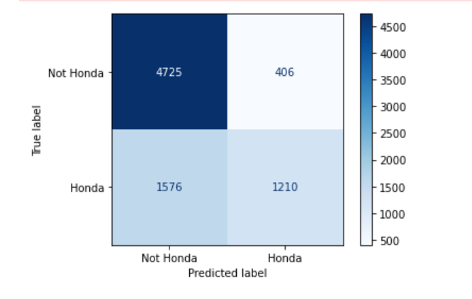
Evaluation of Model 4
True Negative : 4725, False Positive: 406, False Negative: 1576, True Positive: 1210
Accuracy: 0.7497
Misclassification:0.2503
Precision: 0.7488
Recall: 0.4343
Specificity: 0.9209
Our model correctly predicts 74.97% of observations.
Among posts that our model predicted to be in /r/honda, we have 74.88% of them correctly classified.
Among posts that are in /r/honda, our model has 43.43% of them correctly classified.
Among posts that are in /r/mazda, our model has 92.09% of them correctly classified

Slide 12
Evaluation
04

Slide 13
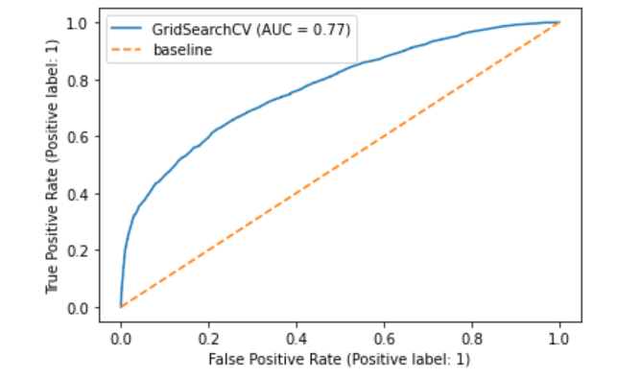
Evaluation of Model 4
ROC AUC is 0.77. The positive and negative populations are clearly separated.
I will not proceed to adjust my threshold as the ROC AUC is reasonable ok. Besides, the objective is mainly to segregate the posts to reduce the unnecessary workload of Customer Service Desk.

Slide 14
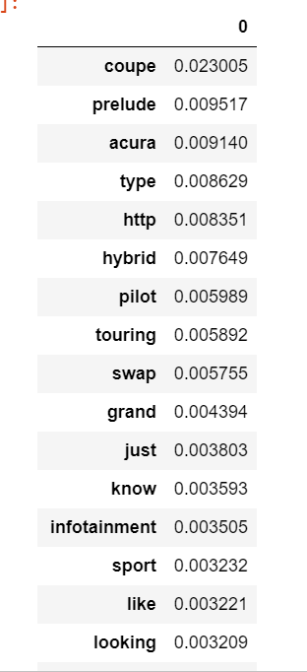
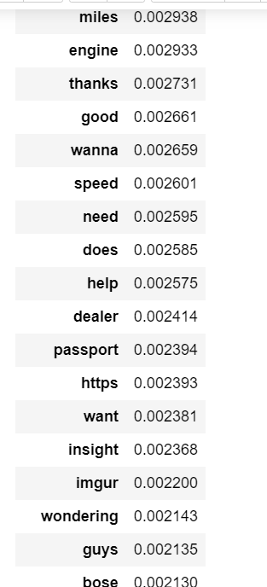
Top Important Features and Probability
Top important Features and Probability

Slide 15
wrongly classified to Mazda post
Honda post wrongly classified to Mazda post
('just', 512), | ('does', 183),
('like', 373), | ('thanks', 181),
('know', 321), | ('really', 174),
('looking', 283), | ('time', 171),
('miles', 228), | ('help', 168),
('want', 216), | ('need', 162),
('good', 211), | ('https', 159),
('sport', 186), | ('going', 155),
('engine', 145), | ('dealership', 154),
('used', 135), | ('work', 150),
('bought', 135), | ('issue', 148),
('driving', 134), | ('drive', 148),
('price', 130), | ('cars', 148),
('touring', 130), | ('think', 128),
('wondering', 129), | ('door', 124
Those in red belong to the top most important words. Top common words 'just','like','know','looking','miles','want','good','sport’, ‘engine’,’touring’. These words are relatively common among all car brands. So, model is not able to predict it properly

Slide 16
wrongly classified to Honda post
Mazda post wrongly classified to Honda
('just', 390), | ('replaced', 125), | ('getting', 155),
('engine', 330), | ('time', 125), | ('start', 152),
('know', 240), | ('does', 119), | ('driving', 145),
('like', 237), | ('looking', 118), | ('problem', 144),
('miles', 237), | ('transmission', 117), | ('check', 142),
('light', 175), | ('good', 114), | ('cars', 142),
('help', 172), | ('check', 113), | ('auto', 139),
('start', 170), | ('going', 110), | ('guys', 139),
('need', 144), | ('work', 109), | ('sure', 138),
('problem', 137), | ('thanks', 107), | ('hybrid', 138),
('issue', 135), | ('fine', 105),
('want', 133), | ('code', 102),
('driving', 131), | ('change', 102),
('battery', 127), | ('guys', 102),
('https', 126), | ('power', 101)]
Above mazda posts are wrongly classified as r/honda post. Top common words 'just','like','engine','know','miles','hybrid’. The word 'hybrid' is likely the word that the model picks up and identify as honda

Slide 17
Insights
The top important features pertaining to Honda:
Coupe
Sports
Hybrid
Infotainment
Miles
Based on above top important features, Honda is synonymous with economical, fuel-efficient automobiles. it’s the classic models, coupe, remains the best of the bunch. These two characteristics can deceive one into thinking they’re simple economy cars or another mildly sporty coupe.
There is also frequent mention of infotainment system. Honda issues a recall for nearly 608,000 vehicles because of instrument panel software problems. The recall affected the 2018-2020 Odyssey, 2019-2020 Passport and 2019-2021 Pilot vehicles with defective instrument panel control modules. So, that explains frequent mention of infotainment in Honda posts.
.

Slide 18
Conclusion
05

Slide 19
Conclusion
My Random Forrest classifier performed well with a test accuracy score of 74.97%. This is within expectations because the topics of our two chosen subreddits is closely related.
On top of it, the mentioned brand name are removed from the train data so that we can subject the model with more stringent conditions.
Subreddit Classifier - A proof of concept web application was developed to demonstrate potential use case.
My application can segregate the posts well. This has been further verified with some mock test messages.
With this, I will seek to further develop the application in our production system.

Slide 20
Further Improvements
Optimize the Stop Words Feature Importance is key to the accuracy of model. Thus, stop words need to be reviewed and added in as we drill deeper in the analysis | Try Other Ensemble Models Examples are XGBoost Classifier
Train with more Reddits With more Reddits as training set, we can obtain more features that are significant to the predicting. | Expand to other irrelevant posts Expand to include segregation of irrelevant posts from other car competitors

